Slide 1
Update data-augmentatie

Slide 2
GliNER
> Zero-shot NER approach on-top of SpaCy library
> Gives oppurtunities to extract term like locations, crops, chemicals,…
> Also on-the go approaches and user-chosen approaches might be a possibility.
> Not flawless. Use-cases needs to be aware of this fact and extra dataprocessing might be needed

Slide 3
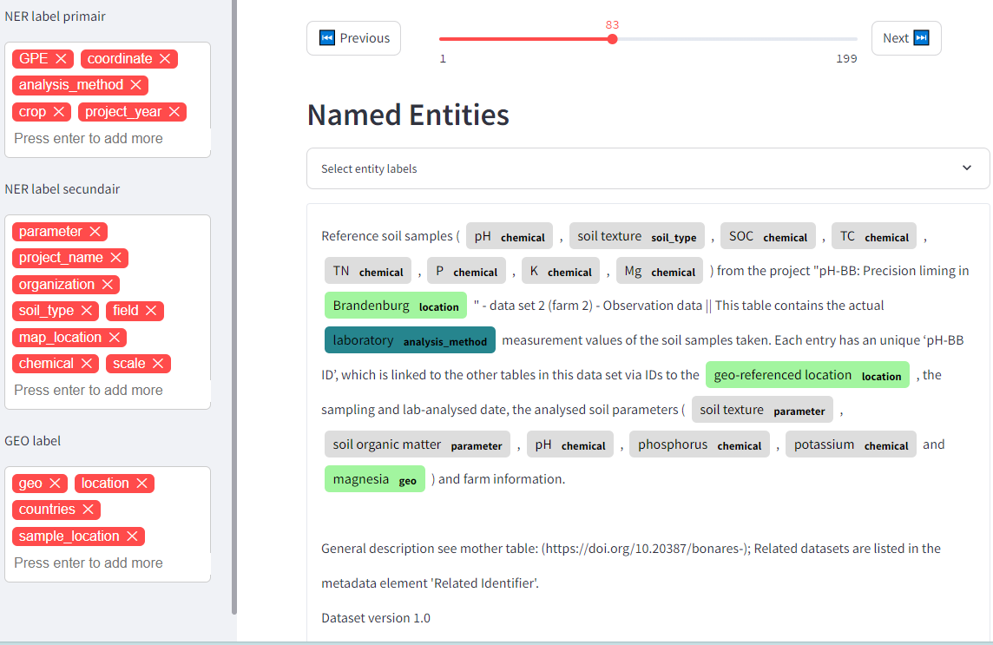
GliNER
-> Example of different NER possibilities

Slide 4
GliNER + OSM
> First anecdotal experience seems to be promissing.
> Retrievel of geoinformation looks good but still a lot of non-mappable locations (‘field’, ‘reference sites’, ‘bog’, ‘kettle hole’,…) are also flagged
-> Hypotese: When querying Open Street Maps these will come back empty and thus be purged

Slide 5
GliNER + OSM
-> Hypotese: When querying Open Street Maps these will come back empty and thus be purged
> Some succes but still too much mistakes:
EU -> village in France
Kettle Hole -> location in US
Open Water -> Location in Texas
Shoreline -> City in Washington
Plots -> Building in Pakistan

Slide 6
OpenAI LLM
> One-shot approach
> system_message = f"""You are an expert in Natural Language Processing. Your task is to identify common Named Entities (NER) in a given text. The possible common Named Entities (NER) types are exclusively: ({", ".join(labels)}).""“ assisstant_message="“ EXAMPLE: Text: 'Soil Maps of Baradi Area, Baga Area, Jagla Area, Garabaria Area, Nabharan Area, Kaliganj Area and Arpara Area. || Soil Maps of Baradi Area, Baga Area, Jagla Area, Garabaria Area, Nabharan Area, Kaliganj Area and Arpara Area.’ {{ "Location": ["Baradi","Baga","Jagla","Garabaria","Nabharan","Kaliganj","Arpara"] }} --"""

Slide 7
OpenAI LLM
> zero-shot approach
> system_message =""“ You are an expert in Natural Language Processing. Your task is to identify common Named Entities (NER) in a given text. The possible common Named Entities (NER) type is exclusively: "Location". However, only locations applicable to the research for which you receive the abstract and title. If no location is found, an empty dict is returned. You also ensure that all entities you return can be mapped unambiguously."""

Slide 8
Hybrid: GliNER + LLM filtering
> Trying to get more accurate results from GliNER model by sorting the dataset with an LLM and replacing entities to mappable entities
> system_message_filter = """ You are an expert in geographical entities with specialized knowledge of OpenStreetMap and Nominatim. Your task is to filter a list of geographical entities, retaining only those that have clearly delineatable locations, such as continents, countries, states, regions, counties, cities, towns, neighborhoods, and street names. Be cautious when filtering: if a label could plausibly represent a specific, mappable location, it should be retained. Only exclude terms that are highly ambiguous or are clearly more likely to refer to general, non-delineatable locations. For example, "site" should only be excluded if it is clearly intended to represent a general area rather than a specific town or place.”””
> system_message_filter+replacing = """You are an expert in geographical entities with specialized knowledge of OpenStreetMap and Nominatim. Your task is to filter a list of geographical entities, retaining only those that have clearly delineatable locations, such as continents, countries, states, regions, counties, cities, towns, neighborhoods, and street names. Be cautious when filtering: if a label could plausibly represent a specific, mappable location, it should be retained. Only exclude terms that are highly ambiguous or are clearly more likely to refer to general, non-delineatable locations. For example, "site" should only be excluded if it is clearly intended to represent a general area rather than a specific town or place. Additionally, if a label is not directly mappable but can be slightly modified to match a specific location (e.g., "West Germany" to "Germany" or "London Area" to "London"), return a dictionary of these changes, where the original label is the key and the modified, mappable location is the value.""“ assisstant_message= ""“ EXAMPLE: Text: {'soil,Belgium,creek,street,West-Vlaanderen,river,Wetland,Lucerne,Pays de la Loire,F4,Rijnland-Palts,London Area’} { "delineatable": ["Belgium","West-Vlaanderen","Lucerne","Pays de la Loire","Rijnland-Palts","London], "Non-delineatable": ["soil","creek","river","Wetland","F4"], "changes":{"London Area":"London"} } """

Slide 9
Evaluation
> Dataset manual labeled with geo-entities that are preferable (easy for OSM query)
> current dataset: 173 items
> Counting exact matched items in the set + validating the matched empty sets
> + Evaluation based on common area after OSM query

Slide 10
Evaluation
Methode | Precision | Recall | F1 score | Precision_area | Recall_area
GliNER | 42,1 % | 62,5 % | 0,503 | 67,3 % | 70,9 %
OpenAI – One Shot | 73,0 % | 74,7 % | 0,718 | 78,7 % | 84,0 %
Open AI – Zero Shot | 75,7 % | 72,8 % | 0,742 | 77,5 % | 82,3 %
Hybrid – Filtering | 48,4 % | 33,7 % | 0,397 | 49,8 % | 51,9 %
Hybrid – Filtering + Replacing | 44,4 % | 30,6 % | 0,363 | 46,4 % | 48,7 %
> Currently clear win for OpenAI -> to-discuss: is the compute-power needed worth it?
> Clear tradeof for precision and recall for the Hybrid approach compared to original dataset; Filtering is too rough
> To-Check: How is the precision of the hybrid approach compared to the OSM ‘filtering’

